Slide 1
Parent Learning Community Groups
2024

Slide 2
Acknowledgement of Country

Slide 3
2024 Overview

Slide 4
Supporting Student Wellbeing
Wednesday 3rd April 2024
5pm-6pm

Slide 5
The Resilience Project - LHS journey commenced 2021
Founder Hugh Van Cuylenburg
GEM
Gratitude (noticing positives around us)
Empathy (being kind to others)
Mindfulness ( remain present in the moment, slow down and feel calm)

Slide 6
Meet Hugh Van Cuylenburg
Video Link Here

Slide 7
Activity. Expressing Gratitude
This was completed by Year 8. Snowball Fight. Get in a circle. Throw the pieces of paper at each other. When I say stop pick up a piece of paper near you and write something positive about the person whose name is on the paper.

Slide 8
MOBILE PHONES, SOCIAL MEDIA and NAVIGATING THE CYBERSPACE

Slide 9
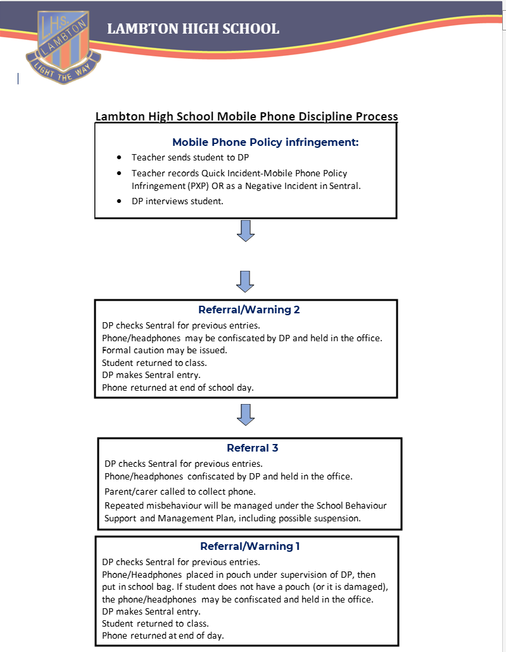
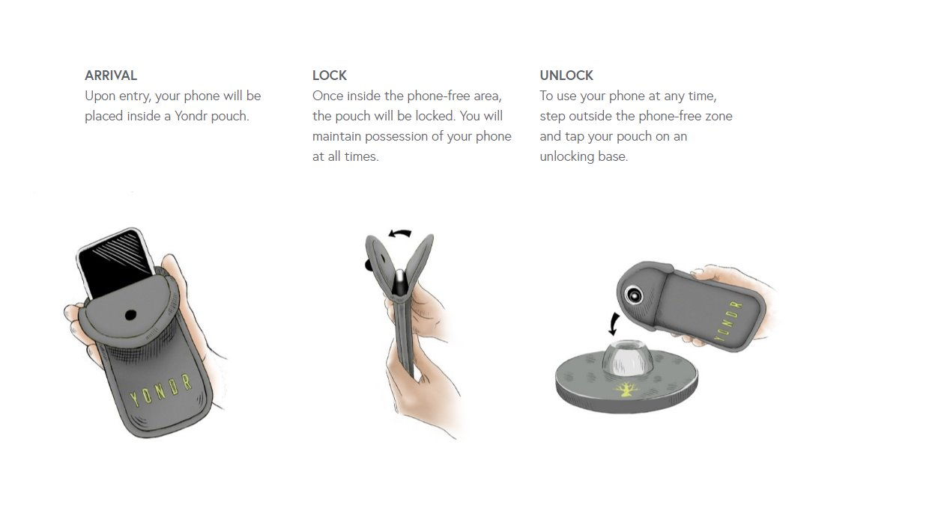
LHS Mobile Phone Policy

Slide 10
Student Expectations
Each student issued a uniquely numbered Yondr pouch
Phones to be switched off / silent and secured in pouch upon arrival for duration of day
Pouches to be in student bags
Includes headphones, airpods, earbuds or any device via bluetooth
Unlock pouches at unlocking station at end of day

Slide 11
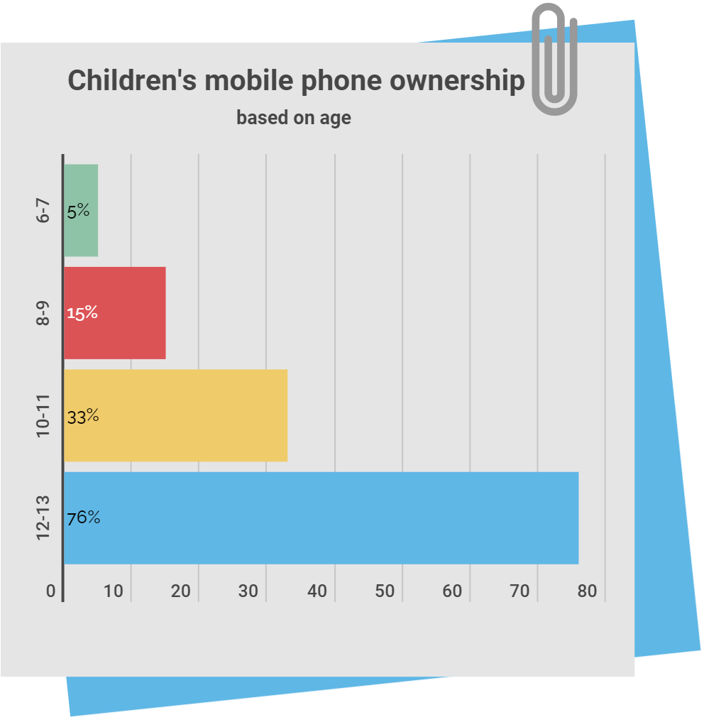
Mobile Phones in High Schools!
whistleout report based on ACMA 202 Data: Link

Slide 12
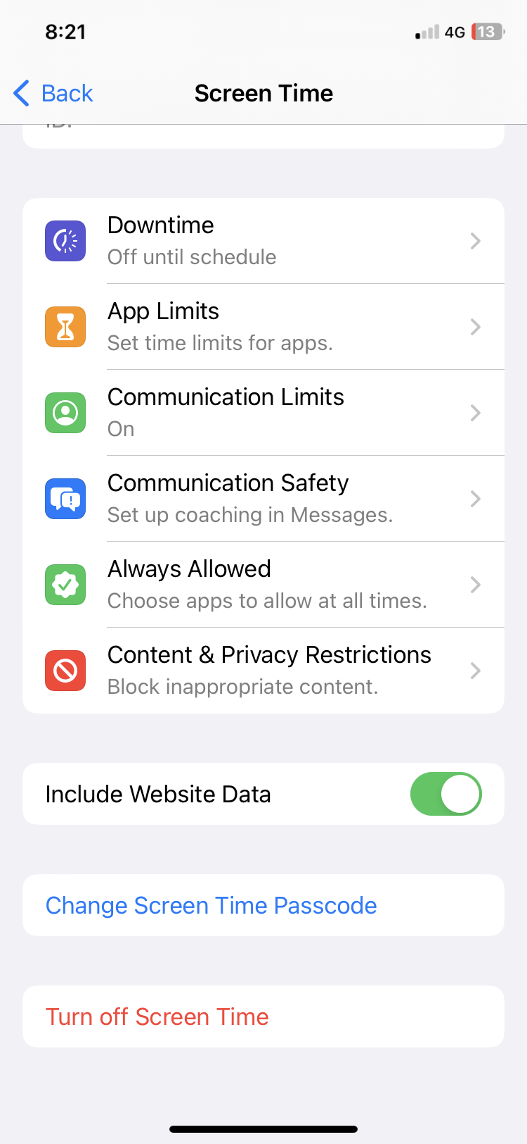
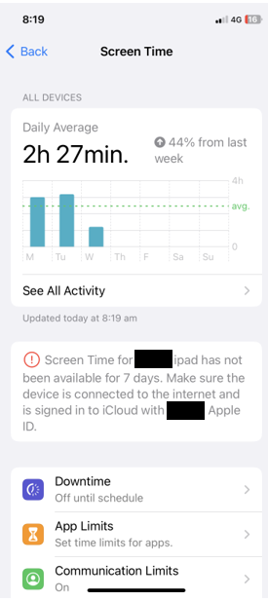
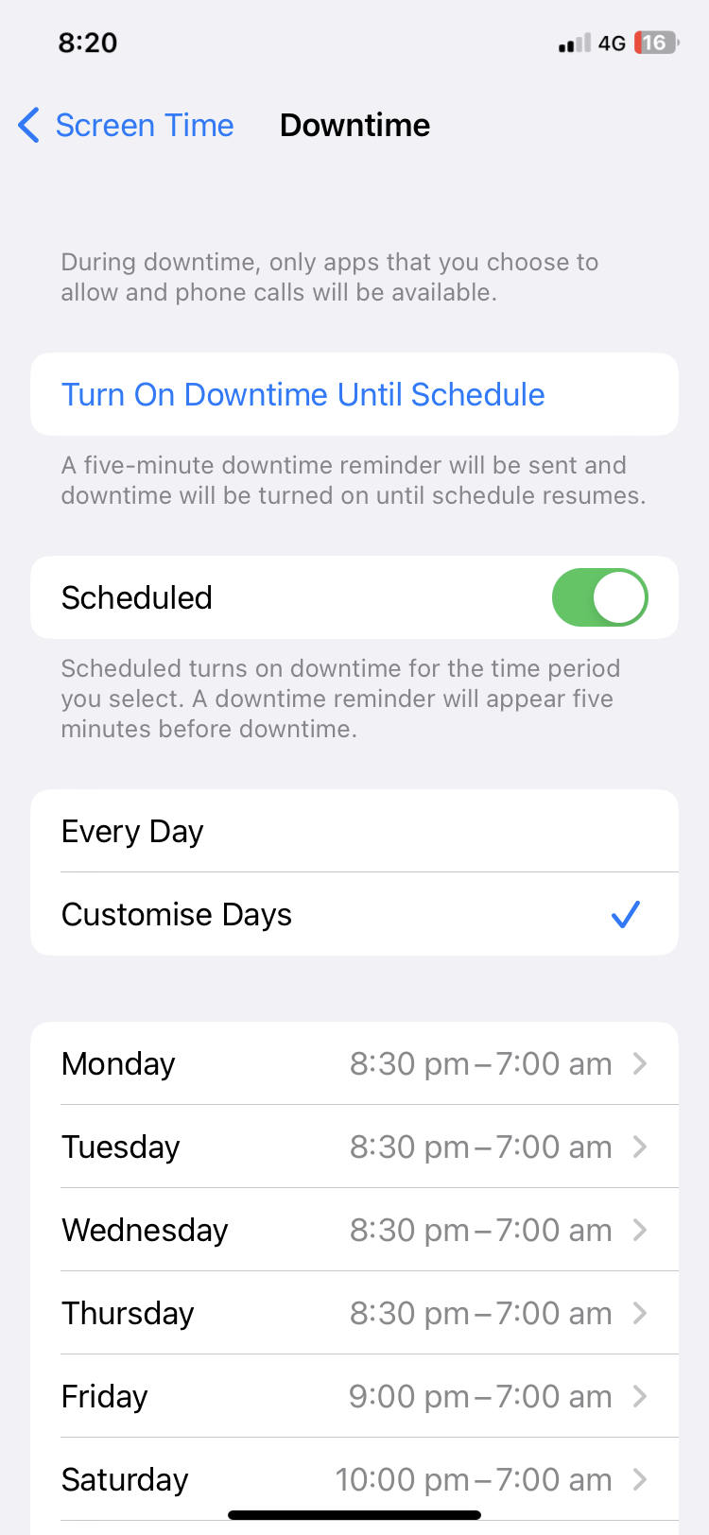
Setting Good Habits - iPhone
e-Safety Commissioner – Screen time

Slide 13
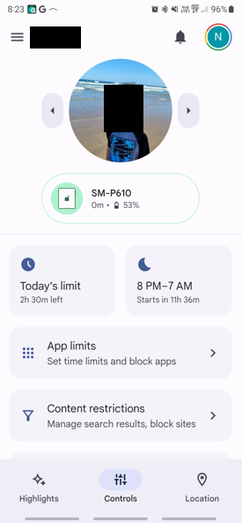
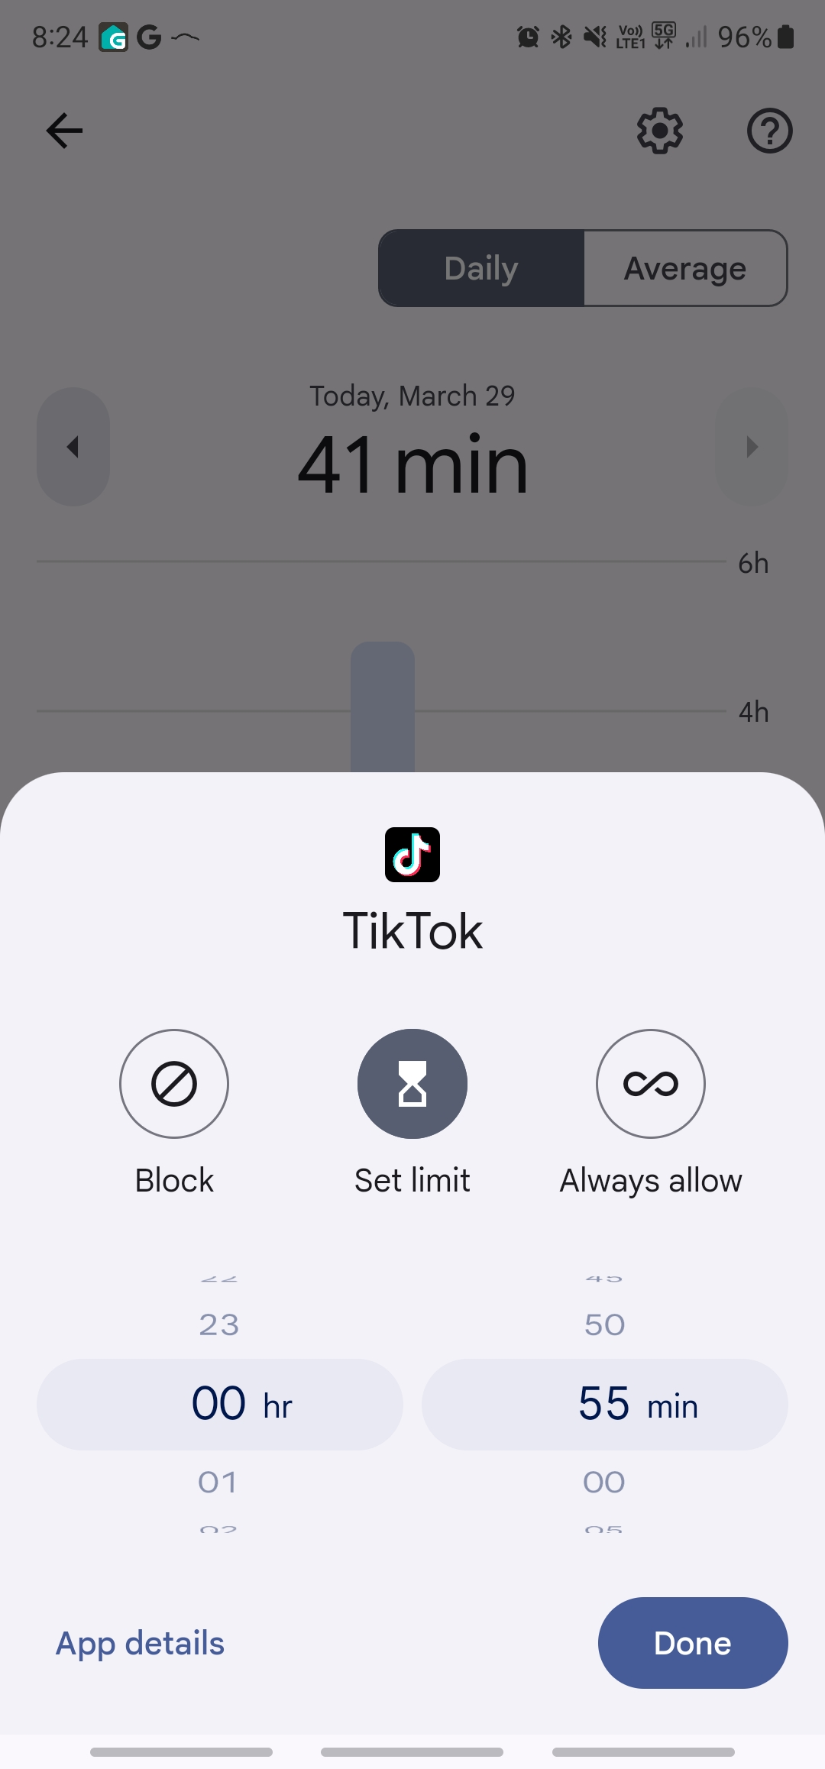
Setting Good Habits - Android
e-Safety Commissioner – Screen time

Slide 14
Setting Good Habits - Generally
Young people - not to share password with peers
Ask your child about the apps and websites they use
Set boundaries - but be realistic
Reassure them that they can always talk to you
Talk about personal information
Talk about social media
Talk about gaming
Talk about cyberbullying
Act on warning signs
Don’t be afraid to have the tough conversations

Slide 15
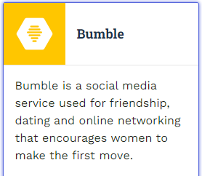
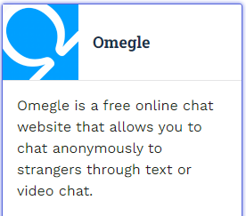
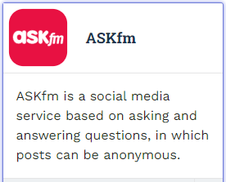
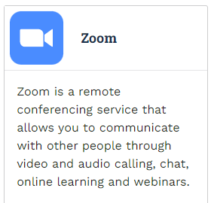
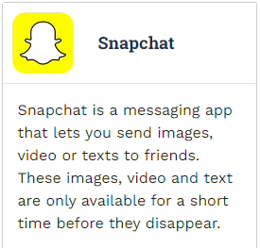
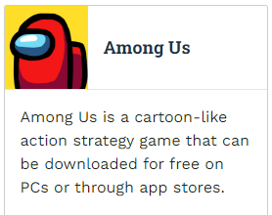
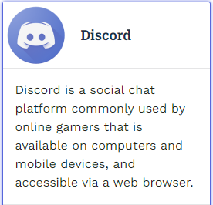
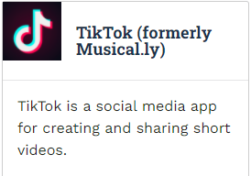
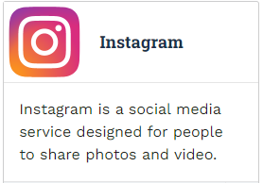
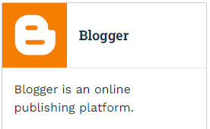
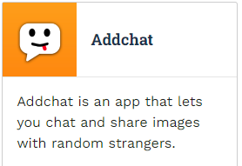
App Information
e-safety Guide

Slide 16
e-Safety and Cyberbullying
“44% of Australian young people report having a negative online experience in the last 6 months, this includes 15% who received threats or abuse online.”
Source: The digital lives of Aussie teens, eSafety Commissioner (2021).

Slide 17
Cyberbullying
Report cyberbullying to eSafety
If the cyberbullying is very serious, and the service or platform does not help you within 48 hours, you can report the harmful content to eSafety using our online form.
Seriously threatening – when someone says they are going to harm you, or tells others to harm you.
Seriously intimidating – when you stop doing something because someone makes you feel scared or bad about it.
Seriously harassing – when someone keeps sending you messages or sharing content about you even though you don’t want them to. Each message or post may not be very bad on its own, but all together they are really upsetting.
Seriously humiliating – when someone posts a really embarrassing comment, image or video to make fun of you.

Slide 18
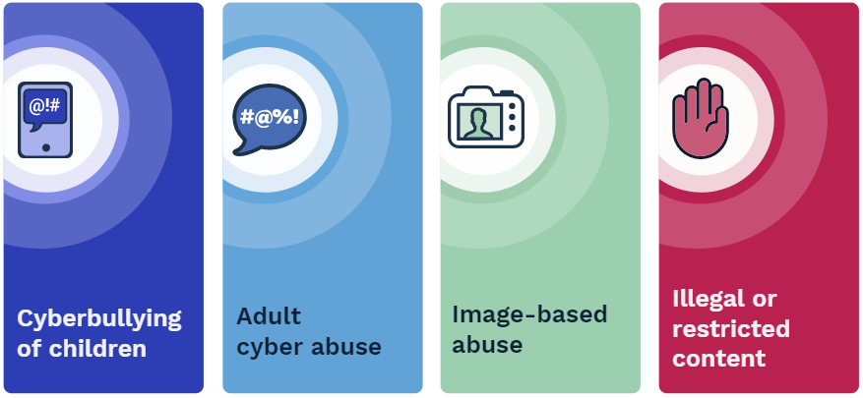
Types of reportable content
* link
esafety link

Slide 19
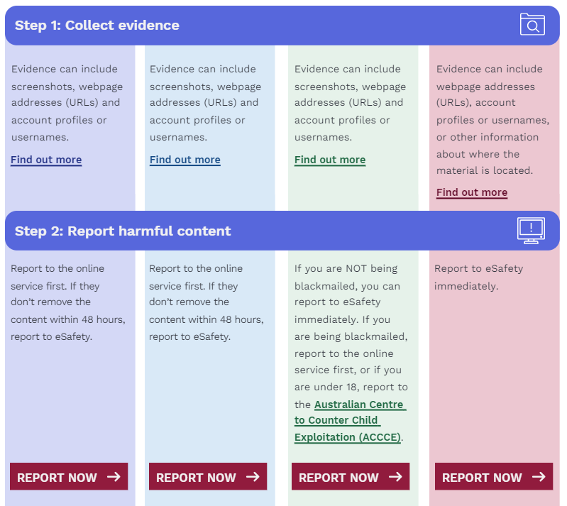
How to Report
esafety link

Slide 20
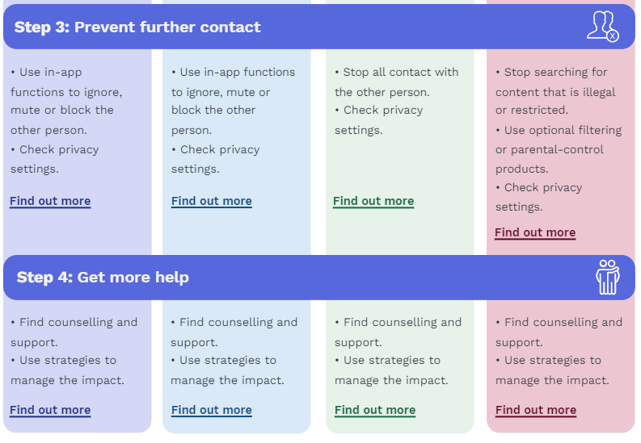
How to Report
esafety link

Slide 21
Checklist
This checklist will help you work out if eSafety can investigate what happened to you.
The person targeted: A child or young person under 18 who lives in Australia.
How bad it has to be: It must be likely to harm the physical or mental health of a child or young person because it makes them feel seriously threatened, seriously intimidated, seriously harassed or seriously humiliated.
When to report it to eSafety: When the harmful content was reported to the site, game or app at least 48 hours ago, but they did not remove it.
Who can report it: The child or young person who was targeted by the cyberbullying or an adult they have asked for help, or the parent or guardian of the child or young person.
Possible outcomes:
The site, game or app removes the harmful content.
The site, game or app is sent a fine or penalty if they don’t remove the harmful content.
The person who did the cyberbullying is told not to do it anymore.
The person who did the cyberbullying is told to say sorry.
e-Safety Checklist

Slide 22
Helpful links for parents
Here are some of the eSafety resources I found which might be useful for parents and the school:
https://www.esafety.gov.au/key-issues/esafety-guide - a list of popular apps with details on how to make a cyberbullying report for that app.
https://www.esafety.gov.au/key-issues/cyberbullying/how-esafety-can-help
https://www.esafety.gov.au/report-online-harm/summary-table-what-you-can-report-and-how - types of abuse and how to report
https://www.esafety.gov.au/key-issues/cyberbullying/schools - resources for schools
https://www.goodschools.com.au/insights/parental-advice/parents-guide-to-social-media-in-2020

Slide 23
Attendance
Notes:
Do you know what the Department of Education’s expectation is re your young person’s % attendance rate is? Research tells us that students with an attendance rate below 90% are educationally at risk. 95% over the course of the year is around about 10 days – if your child is away 5 days a term from school – research tells us that they are educationally at risk.

Slide 24
Justified Reasons for Absences
What if my child has to be away from school?
On occasion, your child may need to be absent from school. Justified reasons for student absences may include:
being sick, or having an infectious disease
having an unavoidable medical appointment
being required to attend a recognised religious holiday
exceptional or urgent family circumstance (e.g. attending a funeral)
Following an absence from school you must ensure that within 7 days you provide your child’s school with a verbal or written explanation for the absence.
What if my child has to be away from school?
On occasion, your child may need to be absent from school. Justified reasons for student absences may include:
being sick, or having an infectious disease
having an unavoidable medical appointment
being required to attend a recognised religious holiday
exceptional or urgent family circumstance (e.g. attending a funeral)
Following an absence from school you must ensure that within 7 days you provide your child’s school with a verbal or written explanation for the absence. You will receive a text message from the school the morning that your child is marked absent
Notes:
We have a pips program whereby staff will call regarding any unjustified absences - . Please ensure your mobile phone is updated if there are changes in your contact details – it is the easiest way to respond to any absences that may be recorded. Being Late to school also affects overall attendance percentages.

Slide 25
Questions to ask yourself
Is your young person getting enough sleep?
Is screen time limited of an evening – at least 1 hour before bedtime?
Is there a pattern emerging re times they say they are sick? (Wednesdays – to avoid sport – are they avoiding a certain subject?
Are there friendship issues?
Are there assessment tasks coming up that your young person is worried about?
Always talk to your GP if you are concerned about your child's mental health
Notes:
Usually when a student’s attendance has dropped, there is an underlying issue. It tends to be a symptom of something else going on with them. Once we know the underlying cause, we can put strategies in place to support them.

Slide 26
Working in partnership with the school.
Avoidance is not a strategy – in fact it can make things far worse
If you notice a pattern emerging, talk to your Year Advisor and we will work together to resolve the problem
Helping your child to attend when things get difficult

Slide 27
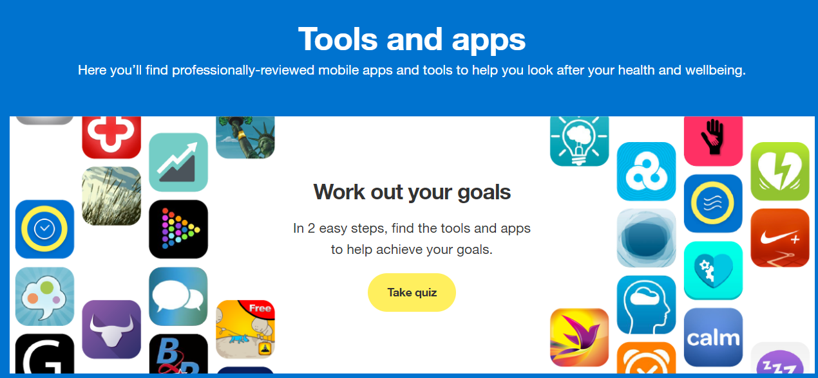
Apps
Apps to support your child
Here are a range of apps to support your child, whatever their mental health issue
By answering a few questions, you can ascertain which apps are best for you.

Slide 28
The Resilience Project
Parent and Carer Hub
A Further Resource
Evidenced Based Strategies that Work

Slide 29
Student Support Officer
Olivia Boglev

Slide 30
The Wellbeing Hub
The Wellbeing Hub is a space available to all students for wellbeing support including:
Individual supports emotional-regulation, caring conversations, developing connections and help seeking skills
Group Supports small groups, workshops, mediations
Follow Up Supports or School-based Referrals supports offered via referral from a Year Advisor, Deputy Principal, Head Teacher, other staff member or following a meeting – usually supported by a warm introduction
Who is in the Hub?
Head Teacher of Wellbeing – Karen Birrell* support plan development, attendance, referrals
Student Support Officer – Olivia Boglev* support plan development, individual and group supports, referrals
Student Learning Support Officer – Jodi Riley* breakfast club, individual and group supports
Recent changes for the Wellbeing Hub:
A thank you to LHS' P&C for providing both the Learning and Wellbeing Hubs with ipads to support students with emotional regulation during timeouts
Located at the top of the stairs to D Block

Slide 31
SSO Role Practice Framework
Strength Based Practice:
Core Social Work Theory
Student's self-determination and strengths are emphasised
Students are viewed as resourceful and resilient in the face of setbacks
Strengthens and expands on characteristics that are already present in students
Considers the individual goals of the student
Ste

Slide 32
Mental Health First Aid Training
MHFA considers:
Early Intervention
Encouraging Help Seeking Behaviours
Responding to a Crisis
Reducing Stigma
MHFA Training Encompasses:
Recognising the signs and symptoms of mental health problems
Use an evidence-based action plan to initiate a mental health first aid conversation
Knowing the barriers to help-seeking and how to overcome these
Assess for a range of crisis situations and provide initial support
Understand the prevalence and impact of mental illnesses, risk factors and treatments and supports available
Mental Health and Crisis includes in MHFA:
Depression
Anxiety and Panic attacks
Psychosis
Substance use problems
Suicidal thoughts and behaviours and Non-suicidal self-injury
Traumatic events
Ste
Mental Health First Aid Training and Youth Mental Health First Aid Training is available to any adult

