Slide 1
Student Mobile Phone Management
Insert your school logo here
Parent Presentation

Slide 2
Why are we implementing this strategy?
This strategy is being implemented to increase focus and learning in classrooms, remove distractions and to promote positive social interactions.
The implementation of this strategy is a requirement under the NSW Department of Education: Students' use of Mobile Phones in Schools policy.

Slide 3
What is the 'locked device pouch' system?
The locked device pouch is a system that will keep your device locked and secure during the school day.
You will be provided with a pouch that will be locked when you arrive and unlocked at the end of the school day.

Slide 4
How the 'locked device pouch' system work?
1
2
3
4
Each morning you will place your mobile phone in airplane mode and then lock it in a pouch.
The mobile phone will stay locked with you throughout the day and cannot receive or send calls or messages.
You retain responsibility for your mobile phone.
When leaving the school, you can unlock your pouch at a designated unlocking station to access your phone.

Slide 5
How Yondr works?

Slide 6
Things to consider.
Late arrival - sign in at student office and lock pouch.
Early leave – report to student office to sign out and unlock.
There will be no earphone/airpods allowed. Same rules.
Smart watches to be used as a watch only. On airplane mode.
Cash or card at canteen.
Excursions – Phones in pouches.
$20 replacement fee if lost or stolen.

Slide 7
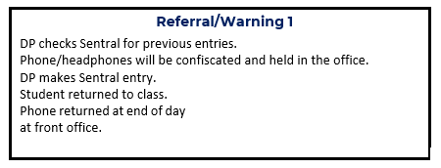
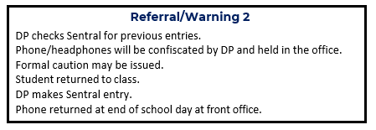
LHS Mobile Phone Discipline process

Slide 8
Key questions
We know this is a big change and we are here to answer your questions!
But first let's go through some commonly asked questions.

Slide 9
Ask your teacher and they can contact the front office who can call your parents or carers if necessary.
What if I need to contact my parents or carers?
As you retain your mobile phone throughout the day, you remain responsible.
Who is responsible for my mobile phone?

Slide 10
Are there any exemptions?
Exemptions will be made for devices that are required for medical or learning requirements.

Slide 11
What will happen if I do not comply?
The school's existing Student Behaviour policy and procedures will be applied.
The mobile phone management strategy applies to school excursions and events unless an exemption is made by the principal. If this is the case information will be included in the excursion permission form.
What about school excursions?

Slide 12
What if I am finding the change challenging?
Make some time to talk to the counsellor or your year advisor who can provide you with some strategies to assist and/or connect you with external services.

